Slide 1
Adversarial Transformation Networks Learning to Generate Adversarial Examples (ATN)
Shumeet Baluja
Google Research
No publish(2017-03)

Slide 2
Outline
Scenario
Observe Imagine
Problem
Multiple Angles
Solution
Theory Tool
Performance
Effectiveness Cost

Slide 3
1
Scenario & Problem
Scenario
a single image perturbation that fools a deep neural network classifier on all natural images?
a single image perturbation that fools many deep neural network classifiers?
Problem
All of prior adversarial perturbations have intrinsic dependence on datapoints: the perturbations are specifically crafted for each data point independently.
Reference: L-BFGS\Deepfool\FGSM

Slide 4
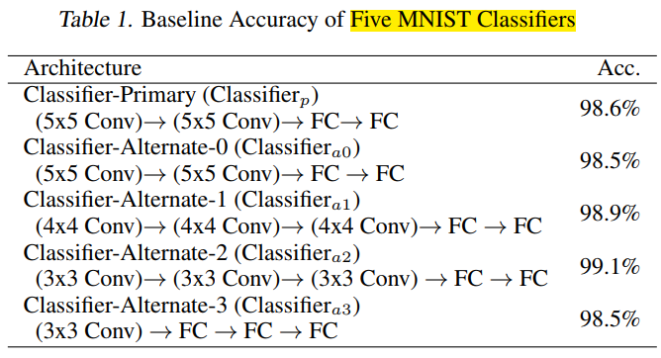
1
Performance

Slide 5
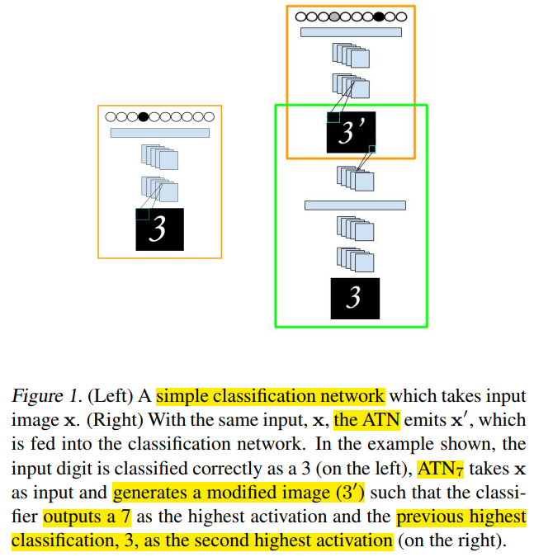
1
Performance

Slide 6
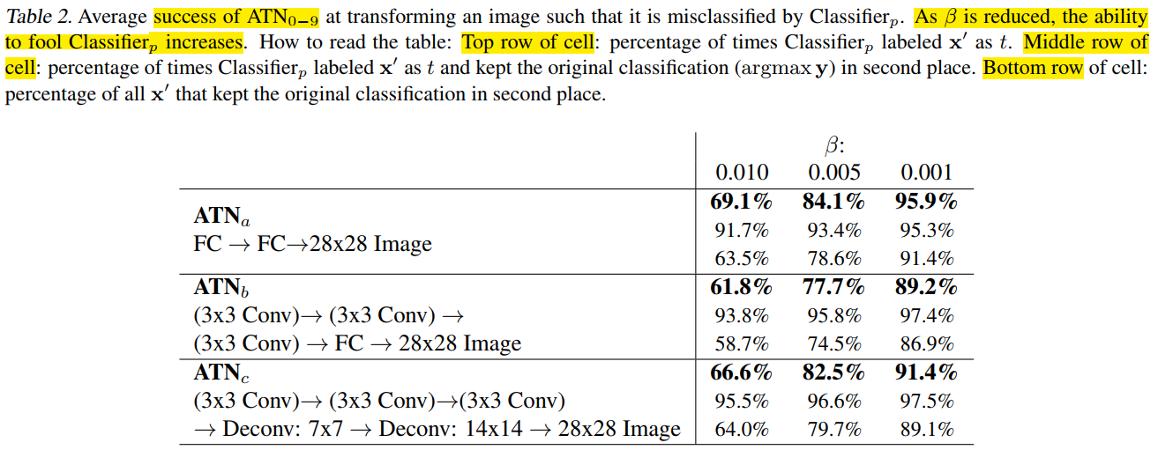
1
Performance

Slide 7
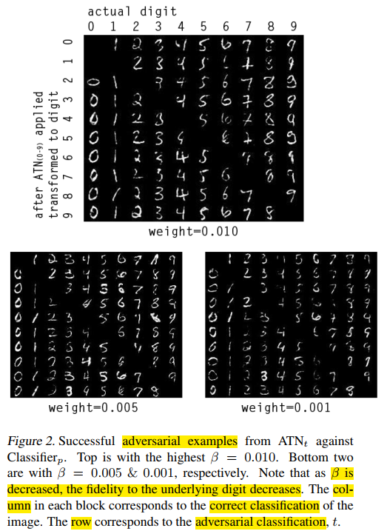
1
Performance

Slide 8
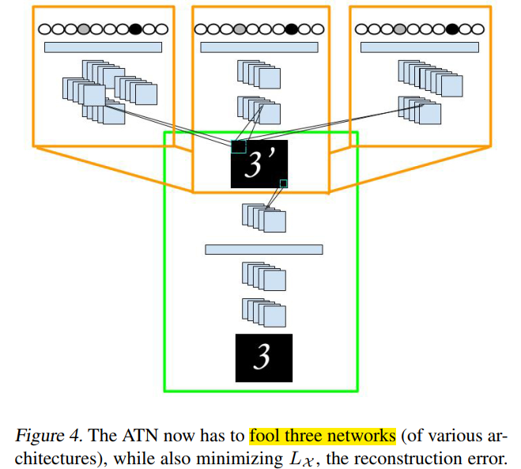
1
Performance

Slide 9
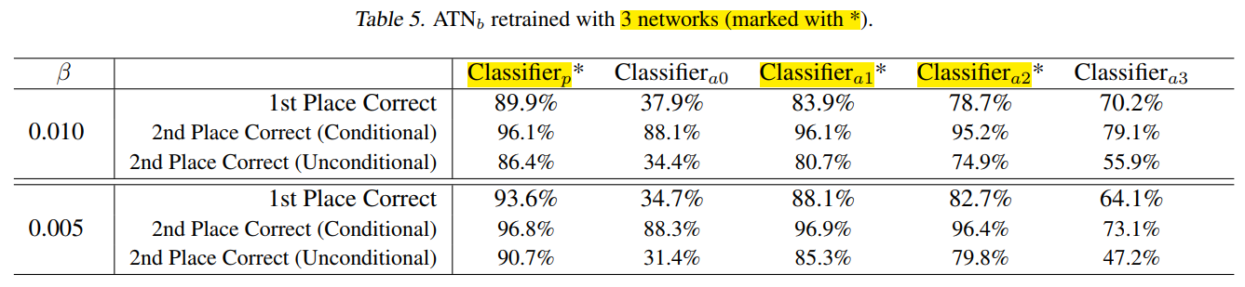
1
Performance

Slide 10
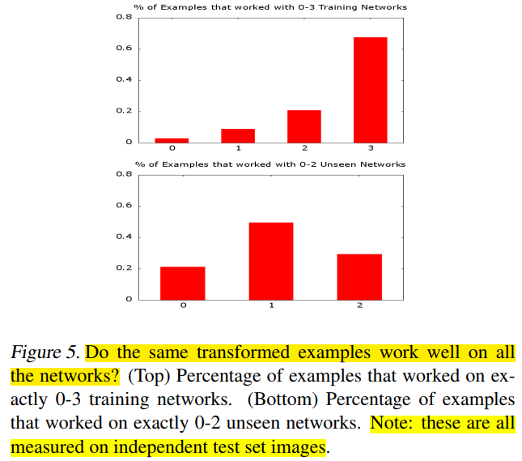
1
Performance

Slide 11
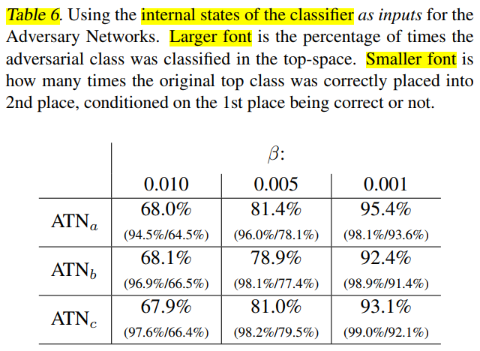
1
Performance

Slide 12
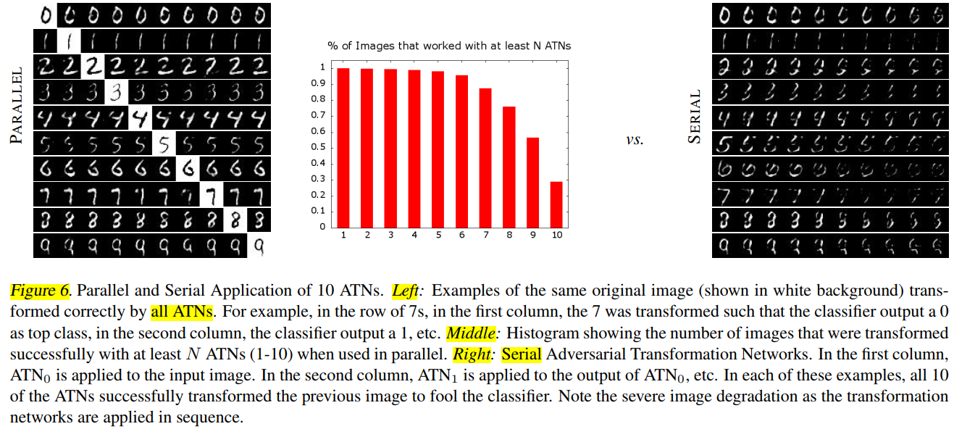
1
Performance

Slide 13
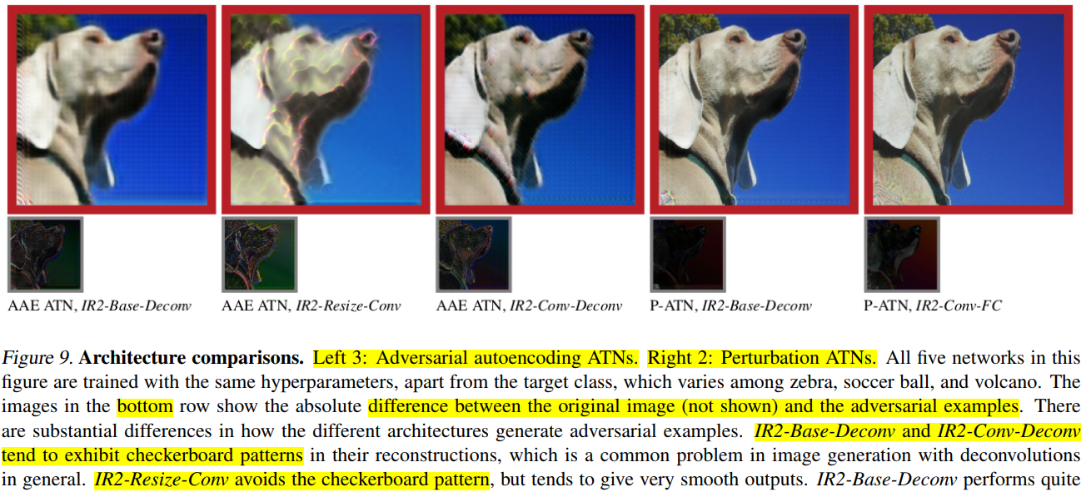
1
Performance

Slide 14
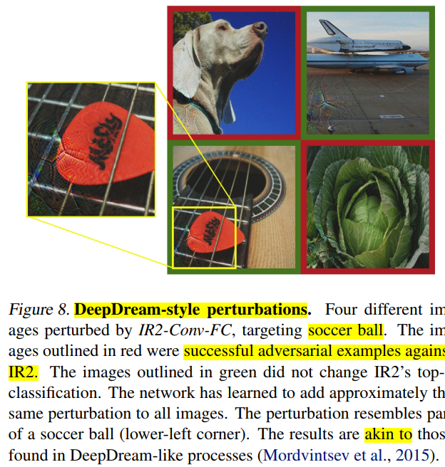
1
Performance

Slide 15
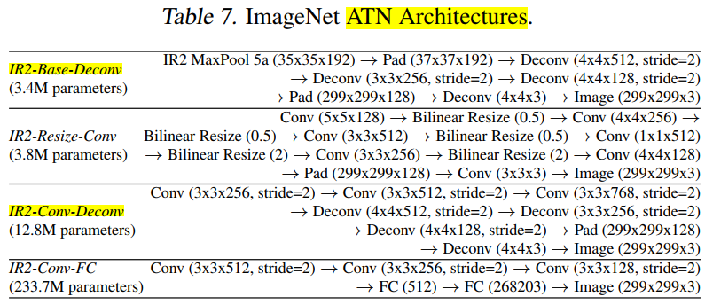
1
Performance

Slide 16
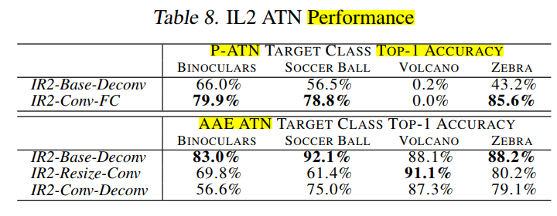
1
Performance

Slide 17
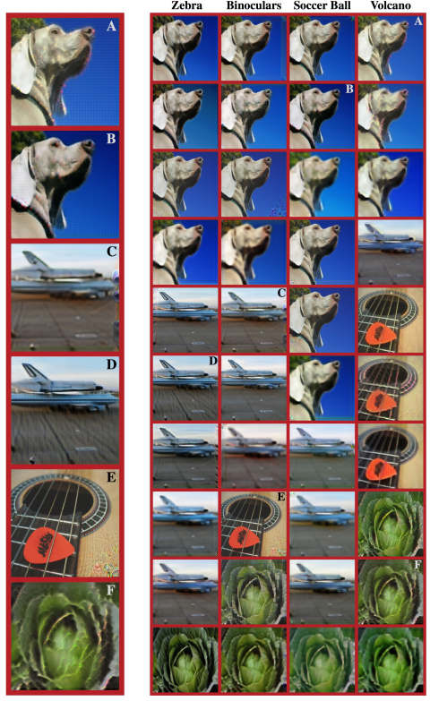
1
Performance

Slide 18
4
Conclusion
两种ATN：
Perturbation ATN（P-ATN）
input x
output r x*=x+r
Auto Encoding
input x
output encoding of x
Adversarial Auto Encoding（AAE）
input x
output adversarial encoding of x

